Slide 1

My Experience as an Intern at NABA

Slide 2
About Me
My Name is Drew Walsworth
I’m a recent graduate from Western Governor’s University graduating with my Bachelor’s Degree (4 Years) in Computer Science. The degree was online and self-paced so I graduated on September 12th of this year (2020).
I have recently participated in and finished a 3 month internship at The New American Business Association (NABA) a partner program of Louisville Institute of Technology (LIT) located in Louisville, Kentucky in roughly 6 weeks.

Slide 3
The experience in a nutshell
I joined a group of 6-8 interns meeting for an hour on weekday mornings from 9:30 AM to 10:30 AM CST Online. I was given access to free books and a Slack channel to discuss topics with our mentor Di Tran and the other interns.
Me and the rest of the group received guidance from an experienced software engineer (Di Tran) on Resume building, Soft Skills, and The Big Picture of the Software Industry.
I was given a set of software development tasks to complete at my own pace focusing on C# and the .NET stack that I completed.
In the end I produced a final project where I developed a Web Fullstack application hosted on Microsoft’s Azure Cloud Platform.

Slide 4
A List of the Technologies used
C# (Main Programming Language)
JavaScript (Website Scripting)
SQL (Relational Databases)
.NET Framework & .NET Core
Microsoft Azure Cloud Platform (To Host a SQL Database and the Web Application)
Microsoft Azure DevOps (For automated build/test and release pipelines (CI/CD))
Microsoft SQL Server / SQL Server Management Studio
React v16.13 (For the Web App)
React Bootstrap (For Bootstrap JavaScript and CSS in React Components)
xUnit (For Unit Testing)
Auth0 (To secure the Web App and Web API)
EPPlus (For Excel Files)

Slide 5
Console Application
I produced a Console Application that can:
Read and Write to:
A Text File (.txt)
An Excel File (.xlsx)
A SQL Database (Local)

Slide 6
Windows Presentation Foundation (WPF) Desktop Application
I produced a WPF App reusing the Console Application’s code that can:
Read and Write to:
A Text File (.txt)
An Excel File (.xlsx)
Perform Create, Read, Update, and Delete operations on:
A Microsoft Access Database (.accdb)
A SQL Database (Local)
An Azure Cloud Hosted SQL Database (Remote)

Slide 7
Person Info Web API (App Service)
Created using ASP.NET Core v3.1
Features the ability to Create, Read, Update, and Delete a Person. (CRUD)
Features HTTP method endpoints using GET, POST, PUT, and DELETE.
Features HTTPS endpoint routing with Auth0 Authorization Middleware for Security.
Features a CORS policy to prevent access except from specific origins, headers, methods, and with specific credentials.
Tested using Postman.
The Web API is only accessible from the React Application without a valid Token, which can only be gotten from logging into the website.
The API is hosted on an Azure Cloud App Service and has tests run against it in an Azure DevOps Build/Test Pipeline (CI) and is automatically deployed with the React Frontend Application to separate Development and Production environments (CD).

Slide 8
React JS Web Application (App Service)
Utilizes functional components with hooks to manage the state of the application.
Utilizes react-bootstrap to style the page and provide a Grid Based Layout functionality.
Utilizes Auth0 Universal Login to protect specific routes and components that require a login for access.
Utilizes tokens requested from Auth0 after logging in to securely access the Web API via HTTPS hosted on Azure Cloud.
The React App is hosted on an Azure Cloud App Service and is built and run in an Azure DevOps Build/Test Pipeline (CI) and is automatically deployed with the Web API to separate Development and Production environments (CD).

Slide 9
Azure Cloud Hosting
Azure App Service
https://drewapiwebapp.azurewebsites.net/
React Web App
(User’s Browser Performs the Requests)
Person Info API
(ASP.NET Core 3.1 Web API)
Call Stored Procedures using Private Connection String
Azure SQL DB
Stored Procedures
Person Table
Sends HTTP Requests with Token
Pages In Orange require Login
Home
Receives HTTPS Response with 200 OK/201 Created/204 No Response if Authorized
OR
Receives HTTPS Response with 401 if Unauthorized
Receive Person Data
Profile
Person API
Login Information & Login Authorization Code
API Token
Auth0 Tenant
Auth0 Universal Login Page
Store a New User or Update information for an Existing User
Auth0 Users/Roles DB
External Identity Provider (Google)

Slide 10

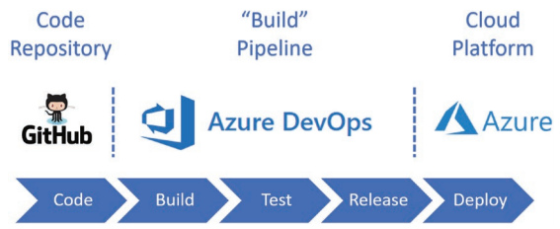
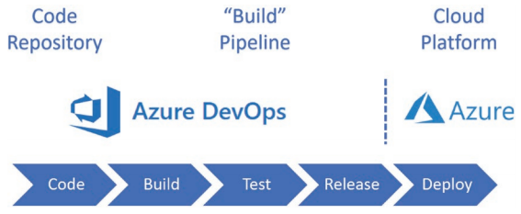
CI/CD Pipelines using Azure DevOps
These Two Pipelines are examples of the pipeline structures that I have learned to make.
The pipeline structure on the bottom right is what the Person Info API is built, tested, and deployed with.
The Pipeline I used for the Person Info API and Web App:

Slide 11
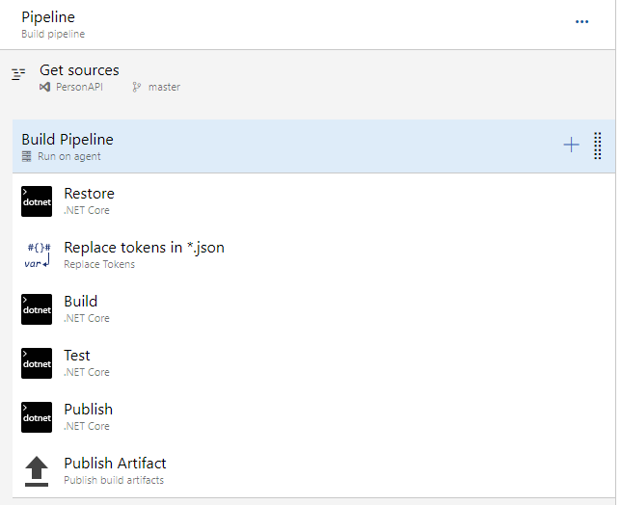
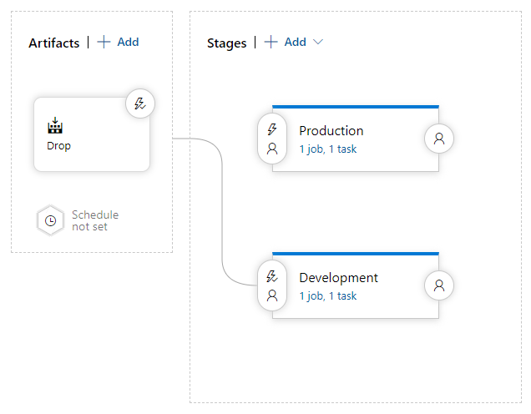
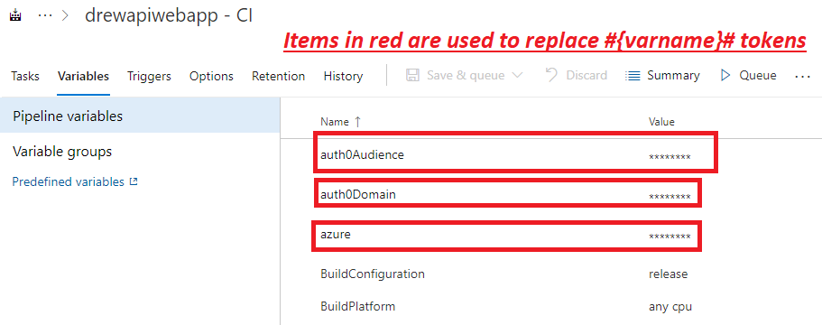
More on The CI/CD Pipeline

Slide 12
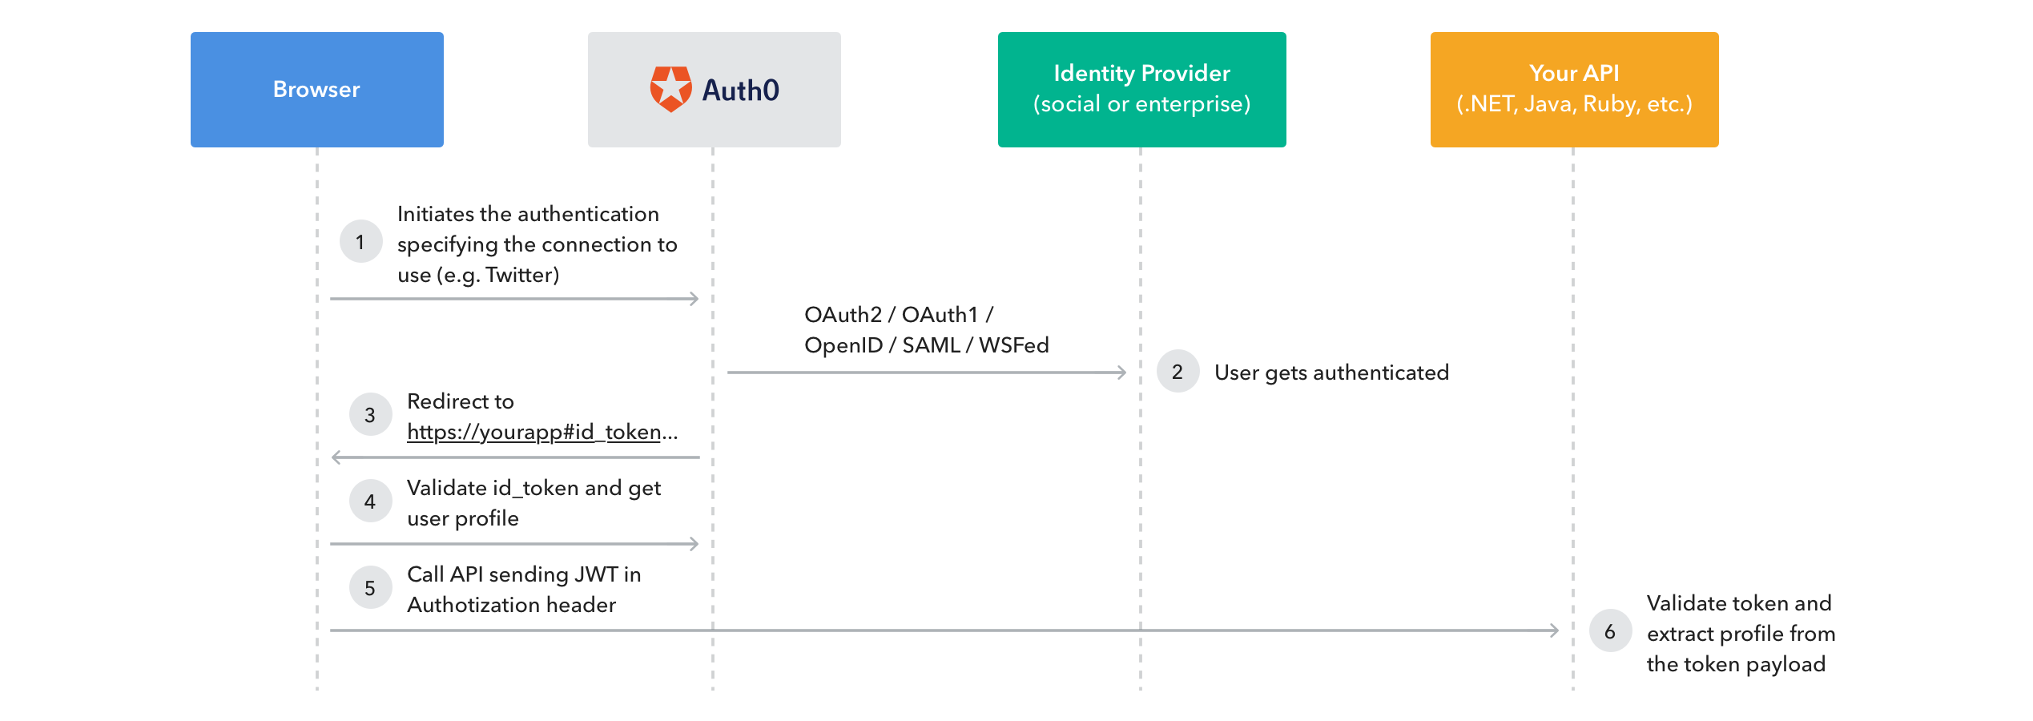
Auth0 Security Diagram

Slide 13
What did I gain throughout this program?
I definitely feel like my mentality towards getting a job has improved for the better in terms of feeling less uncomfortable/more confident now that I have a project worth showing to a potential interviewer/employer.
I have a more practical programming skillset now, and a more solid resume and GitHub portfolio. I learned what a REST API is, how to make one, secure one, how to make a React Front End Application and make HTTP requests from it and how to do a bunch of things using Visual Studio and Visual Studio Code that I never knew before. Conceptually I learned about Dependency Injection (DI), Inversion of Control (IoC), Static classes & Extension methods, what a Repository is, and what a DbContext is, etc..
I have a better understanding of what there is in the world of software and I have a set of resources that I am planning to use for future skill improvement.
I feel like I have a better System Design/Architecture mindset now because to be honest I didn’t even have one before because all my apps were simple standalone applications. Before this the only multi tier application I made was a simple two-tier application that I made for my Capstone project in College.
And I would say that now that I’ve completed an internship, I feel like I’m ready to get started working as a Junior Software Developer.

